Slide 1
Social Network Analysis of Amherst College Facebook Connections
By: Amit Raj
Faculty of Computer Science
Network Science
Moscow 2025

Slide 2
Project Overview
Objective:
Analyze the Amherst College Facebook network (2,235 nodes, 90,954 edges)
Identify communities and key influencers
Methods:
Community detection (Louvain, Label Propagation, Girvan-Newman)
Centrality measures (Degree, Betweenness, Eigenvector)
Tools: Python (NetworkX, Pandas, Matplotlib)

Slide 3
Network Properties
Network Summary:
Edges: 90954 undirected friendships
Network Type: Undirected, Homogeneous, Unweighted
Average Degree: 81.39
Network Density: 0.036433
Directed/Undirected: Undirected (Facebook friendships are mutual).
Heterogeneous/Homogeneous: Homogeneous
Weighted/Unweighted: Unweighted

Slide 4
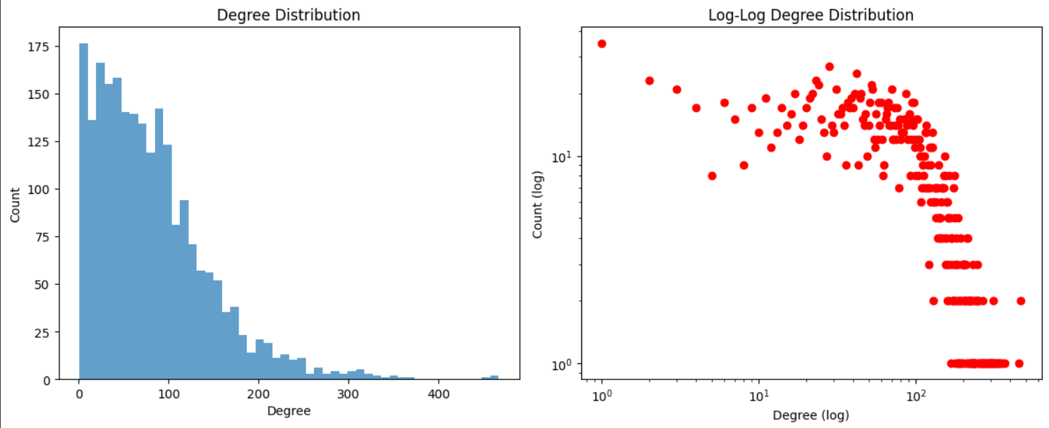
Degree Distribution
Key Metrics:
Avg. Degree: 81.39 | Clustering: 0.45 (12.5× random)
Avg. Path Length: 2.2 (Small-world effect)

Slide 5
Average Distance & Small-World Property
Average Path Length (LCC): ~2.20 (any two users are ~2.2 steps apart on average).
The network exhibits small-world properties—high clustering (friends of friends tend to know each other) and short path lengths (any two people are connected via a few intermediaries).
Observed Clustering Coefficient: ~0.45 (45% chance that two friends of a user are also friends).
The actual clustering is ~12.5× higher than in a random network.
This high clustering is typical of social networks (people form tightly knit friend groups).

Slide 6
Structural Analysis
The Amherst network is a hybrid of BA and WS:
BA-like: Scale-free hubs (e.g., popular individuals).
WS-like: High clustering (friend groups).
Neither model alone captures both properties perfectly.

Slide 7
Structural Analysis
The Amherst network is a hybrid of BA and WS:
BA-like: Scale-free hubs (e.g., popular individuals).
WS-like: High clustering (friend groups).
Neither model alone captures both properties perfectly.

Slide 8
Thank You!
18/18

